Slide 1
Module-1:
BASICS OF C PROGRAMMING

Slide 2
Module-1: BASICS OF C PROGRAMMING :
Introduction to programming paradigms: Applications of C Language, Structure of C program
C programming: Data Types, Constants, Enumeration Constants, Keywords.
Operators: Precedence and Associativity, Expressions, Input/Output statements, Assignment statements, Decision making statements, Switch statement, Looping statements Preprocessor directives, Compilation process.

Slide 3
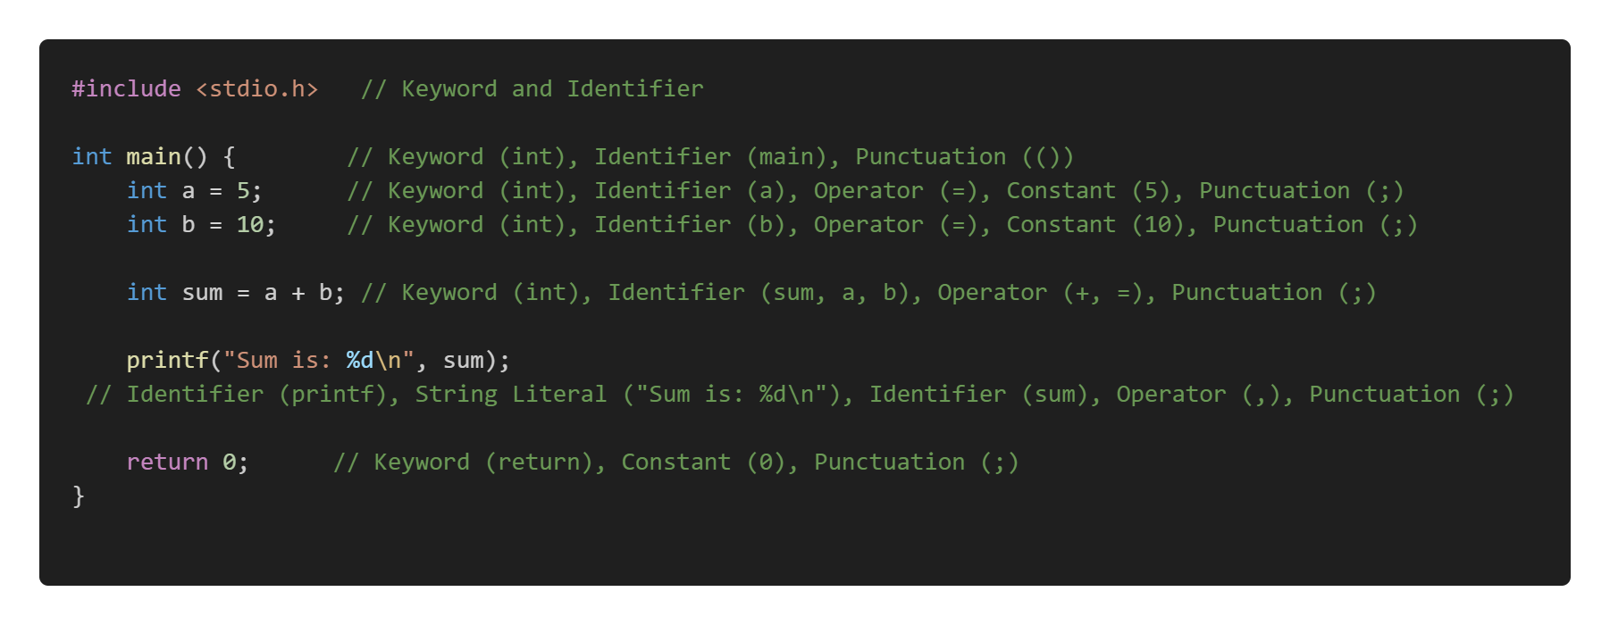
C Program Example:

Slide 4
C Tokens:
In C, tokens are the smallest units in a program that have meaningful representation. They are the building blocks of the language.
There are several types of tokens in C, which are categorized as follows:
Types of C Tokens
Keywords
Identifiers
Constants
Literals
Operators
Punctuation (Separators)

Slide 5
1. Keywords
Keywords are reserved words in C that have special meaning and cannot be used as identifiers (variable names, function names, etc.). Each keyword in C has a specific meaning and purpose in the program.
Examples of keywords: int, return, if, while, for, switch, void, break, continue, struct
Explanation:
int: Declares integer variables.
return: Exits from a function and optionally returns a value.
if, else: Conditional statements.
2. Identifiers
Identifiers are the names given to various program elements like variables, functions, arrays, and structures. An identifier must begin with a letter (a-z, A-Z) or an underscore (_), followed by letters, digits (0-9), or underscores.
Examples of identifiers: num, sum, average, totalAmount
Explanation:
Identifiers help in distinguishing different entities in a program.
They should not match any of the keywords.

Slide 6
3. Constants:
Constants represent fixed values in a program, which doesn’t change thought the life cycle of the Program
1. Integer Constants: These are whole numbers without decimals.
Example: 10, -5, 0
2. Floating-point Constants: These represent real numbers with decimals.
Example: 3.14, -0.5, 2.0
3. Character Constants: These represent single characters enclosed in single quotes.
Example: 'A', '1', ‘%’
4. String Constants: These represent a sequence of characters enclosed in double quotes.
Example: "Hello, World!"
Explanation:
Constants represent values that remain unchanged during program execution.
The type of the constant is determined by its form, such as integer, floating-point, or character.

Slide 7
4. Literals:
In C, literals refer to fixed values that are directly used in a program. They represent constant values used in the program and can be of various types. Example Values assigned to a variable int a =10;
The literal types in C include:
Integer Literals
Floating-point Literals
Character Literals
String Literals
Boolean Literals (C99 and later)
Void Pointer Literals (C99 and later)

Slide 8
5. Operators:
In C, operators are symbols used to perform operations on variables and values. Operators can be classified based on the number of operands they operate on. The main classifications are Unary, Binary, and Ternary operators.
Operators are symbols that perform operations on variables and values.
Example: +, -, *, =, ==, +=, --, ++ and so on.
6. Punctuation (Separators):
Punctuation marks (also called separators) are symbols used to separate different parts of a program, such as statements, declarations, and arguments.
Example: {}, [], (), ., /, :, and so on.

Slide 9
Programming Paradigms (Models):
Programming paradigms are foundational styles or approaches to programming that provide a way to structure and organize code. They define how problems are formulated and solved in programming.
Imperative Programming: Focuses on how a program operates.
Examples: C, Python (imperative style), Java.
Declarative Programming: Focuses on what the program should accomplish rather than how it is achieved.
Examples: SQL, HTML, Prolog.
Procedural Programming (How to Do): A subset of imperative programming that organizes code into reusable procedures or functions.
Examples: C, Pascal.
Functional Programming (What to Do): Treats computation as the evaluation of mathematical functions, avoiding changing state and mutable data.
Object-Oriented Programming (OOP): Models real-world entities using objects and classes. Examples: Java, C++, Python (OOP style).

Slide 10
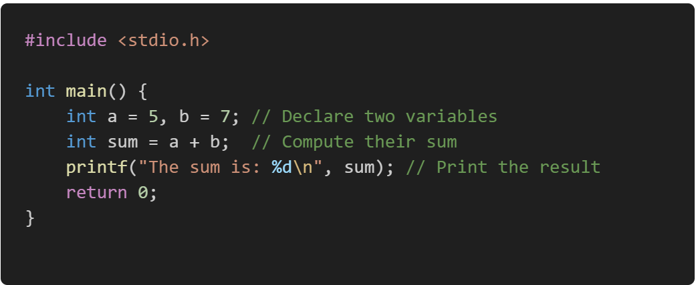
1. Imperative Programming:
Here we need to specify the exact sequence of steps or instructions that the computer must follow to achieve a desired result.
In an imperative programming style, the programmer provides detailed instructions to the computer, including how data is processed, modified, and stored.
Here is an example of summing the numbers imperatively:

Slide 11

2. Declarative Programming:
In declarative programming, you state what the program should do and let the underlying system handle how to achieve it.
Example in SQL:

Slide 12
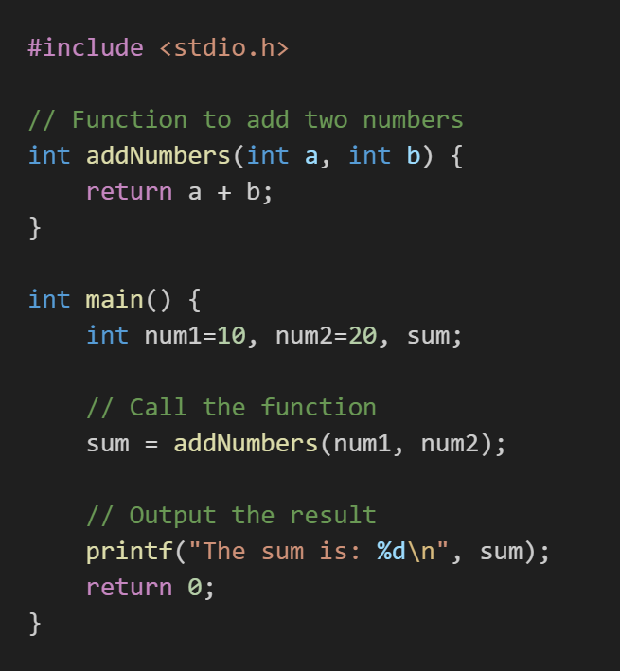
3. Procedural Programming (How to Do):
Procedural programming is a programming paradigm derived from imperative programming that emphasizes breaking down a program into procedures or functions.
These procedures are reusable blocks of code that perform a specific task. Procedural programming focuses on a sequence of instructions executed in a defined order to achieve a specific outcome.

Slide 13
Explanation: Why it is Procedural?
It organizes the solution into a sequence of steps (defining a Procedure, calling it, and printing the result).
It is procedural because:
It uses mutable variables (num1, num2, sum) to manage state.
Procedures (like addNumbers) are used to perform specific tasks.
Focuses on step-by-step execution.

Slide 14
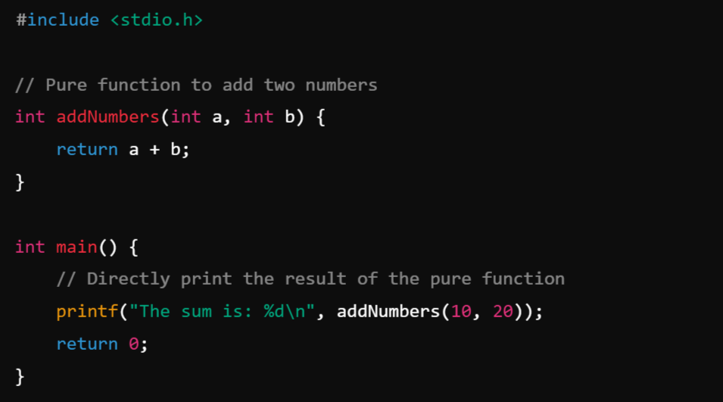
4. Functional programming (What to Do) :
Functional programming is a programming paradigm where computation is treated as the evaluation of mathematical functions, avoiding changing state and mutable data. It emphasizes what to do rather than how to do it, focusing on the use of pure functions, immutability, and function composition.
Example:
How to Convert Procedure to Function:
Avoid mutable variables.
Use pure functions and directly pass inputs and outputs without modifying any state.

Slide 15
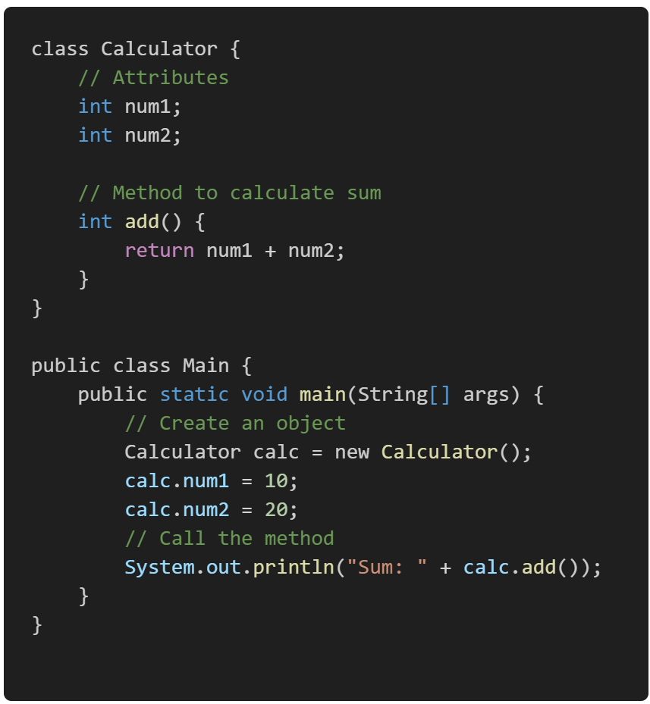
5. Object-Oriented Programming (OOP)?
Object-Oriented Programming (OOP) is a programming paradigm based on the concept of objects, which are instances of classes.
These objects encapsulate data (attributes) and behavior (methods), allowing for modular, reusable, and maintainable code.
OOP promotes the organization of code into real-world entities, making it easier to design complex systems.

Slide 16
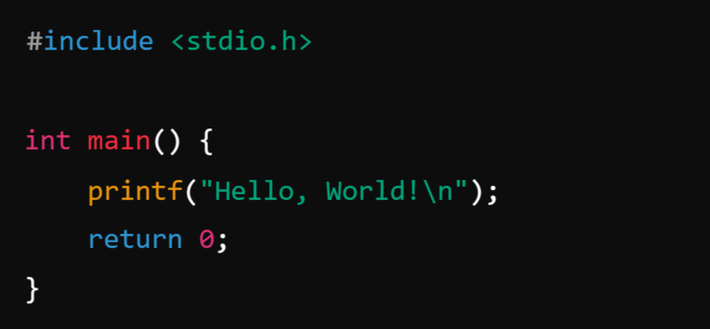
What is C Programming?
C is primarily classified as an imperative procedural programming language, but it also supports some features of other paradigms to a limited extent.
C was developed by Dennis Ritchie in the early 1970s at Bell Labs. It has had a profound influence on many programming languages and is still widely used today, especially in system programming, embedded systems, and operating systems development.
Here’s a simple C program that prints "Hello, World!" to the console:

Slide 17
What is Procedure?
A procedure in programming refers to a set of instructions or a block of code designed to perform a specific task or operation. Procedures are typically used to encapsulate functionality that can be reused in different parts of a program. In some programming languages, procedures are also called functions, methods, or subroutines.
Note:
No Return Value (in some languages): In some contexts, procedures do not return any value, unlike functions that usually return a result. Procedures are simply called to perform an action.
Encapsulation: A procedure encapsulates a specific set of instructions that perform a defined task. It allows you to avoid repeating the same code and makes your program more modular and organized
Parameters (Optional): A procedure can take input parameters, which allow you to pass data to the procedure. These parameters help the procedure perform its task dynamically based on the input.
Reusability: Once a procedure is defined, you can call it as many times as needed without rewriting the code.

Slide 18
Types of Procedures:
1. Void Procedure (No Return Value):
A Void Procedure is a procedure that performs an operation but does not return any value. It may perform an action like printing a result or modifying some data.
Example: Add Two Numbers and Print the Result (Void Procedure)
2. Function Procedure (Returns a Value)
A Function Procedure is a procedure that returns a value after performing its task. The value could be any type, such as an integer, float, string, etc.
Example: Add Two Numbers and Return the Result (Function Procedure)

Slide 19
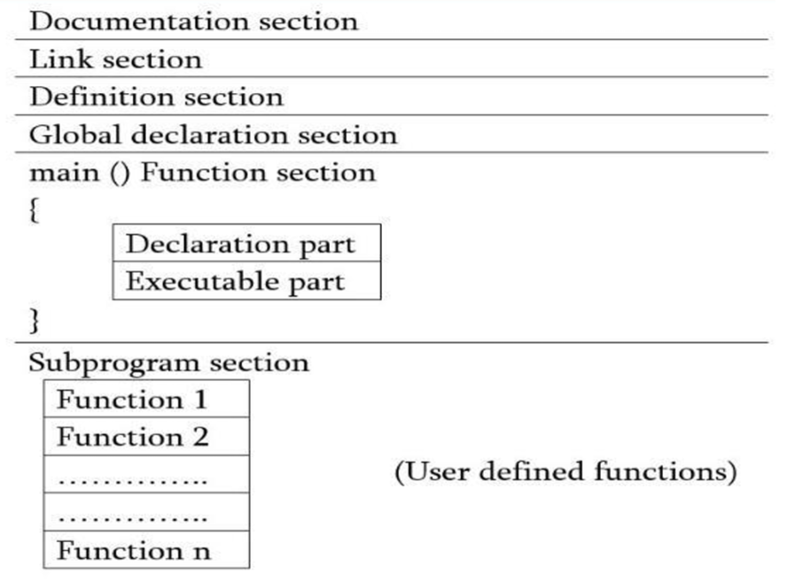
Structure of C program:
The structure of a C program generally follows a specific order of components to ensure proper execution and clarity. Here's an outline of the basic structure:
Basic Structure of a C Program:
Documentation Section
Link Section or Preprocessor Directives
Definition Section
Global Declarations
Function Declarations or Prototype
Main Function
Function Definitions

Slide 20
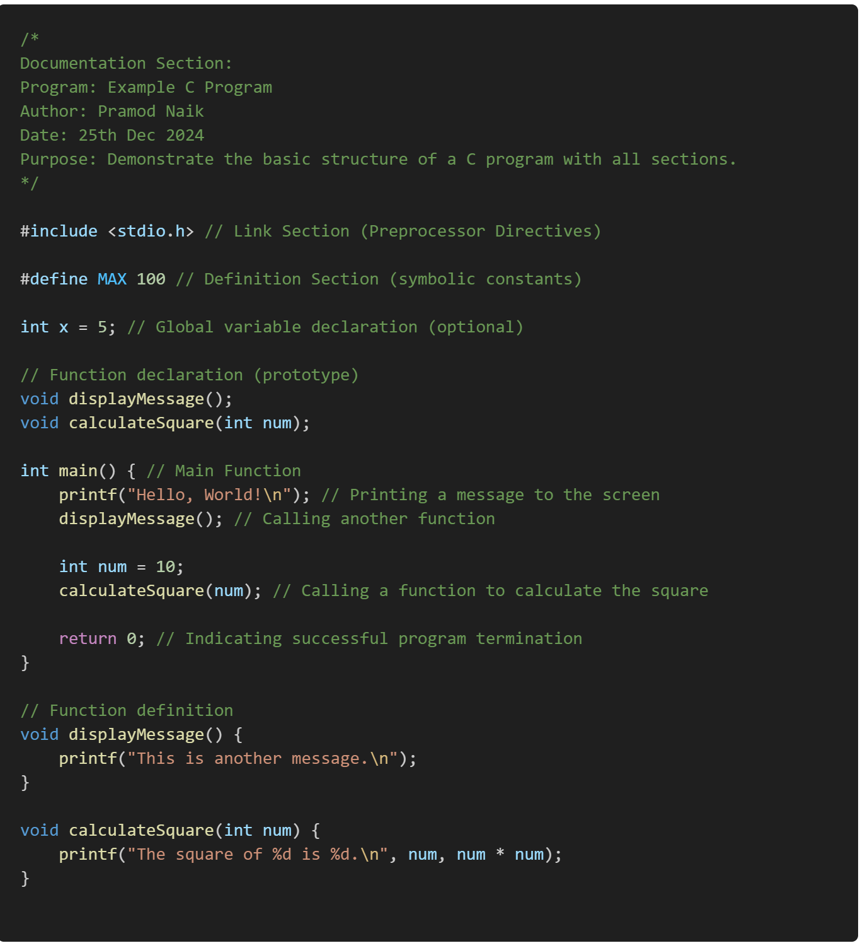
Example:
Structure of C Program

Slide 21
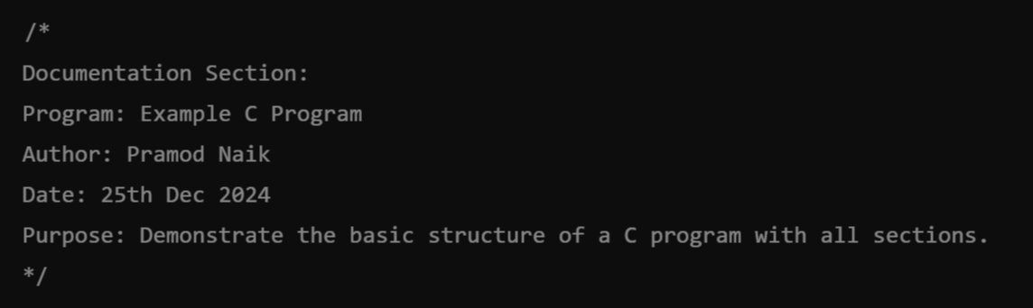
1. . Documentation Section:
The documentation section consists of a set of comment lines giving the name of the program, the author and other details, which the programmer would like to use later.
This is where comments about the program are added, such as its purpose, author, date, and other metadata.
Example:

Slide 22
2. Preprocessor Directives or Link Section:
These are used to include external files, libraries, or to define constants. Preprocessor directives start with #, and they are processed before the actual compilation of the code begins.
Includes headers and macros for external libraries or preprocessor directives.
The link section provides instructions to the compiler to link functions from the system library such as using the #include directive.
Example:

Slide 23
3. Definition Section:
The definition section defines all symbolic constants such using the #define directive.
Used for defining symbolic constants and macros, often part of preprocessor directives.
Example:

Slide 24

4. Global Declarations:
There are some variables that are used in more than one function. Such variables are called global variables and are declared in the global declaration section that is outside of all the functions.
This section is optional. If your program requires global variables or function declarations, they are declared here.
Example:

Slide 25
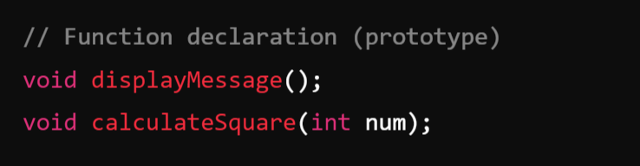
5. Function Declarations or Prototypes:
Declare the functions used in the program. This informs the compiler about the function's name, return type, and parameters.
This is very important if you define your function after the main() method such that compiler need to know the prototype or declaration of your function before starting executing main method.
Example:

Slide 26
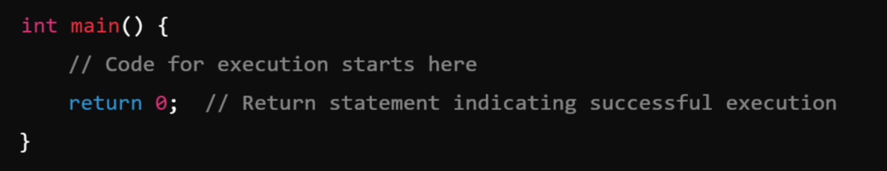
6. Main Function:
The main() function is where the program starts executing. Every C program must have one main() function.
Note: In the C program, return 0; in the main function indicates that the program has successfully executed without any errors.
When the program reaches return 0;, it ends the main() function and sends the value 0 back to the operating system. This is known as the exit status of the program, which is typically used by the operating system or the calling process to determine whether the program ran successfully.
If you had return 1; instead of return 0;, it would indicate an error in the program. In such cases, the program might exit with a non-zero status to indicate a failure.

Slide 27
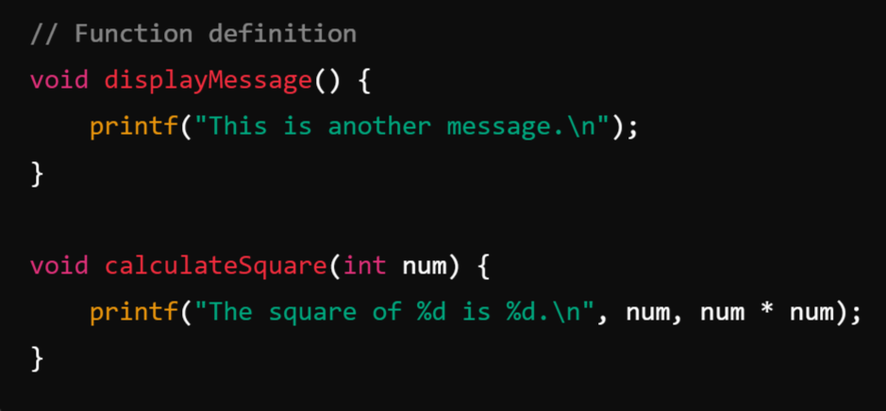
7. Function Definitions:
Functions may be declared and defined either before or after main(). These are optional unless your program requires additional logic beyond the main() function.
Example:
Note:
In C, function declarations (also known as function prototypes) should be placed before the main() function or any other function that calls them. This ensures that the compiler knows about the function's signature (name, return type, and parameters) before it is used in the program.

Slide 28

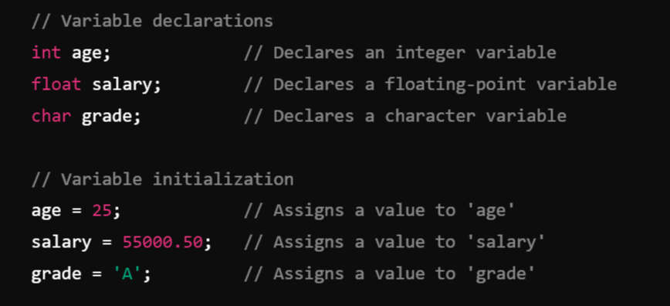
Variable: ( Name given to the memory location):
A variable is a named location in memory that stores data that can be modified during program execution. A variable is used to represent data that the program can manipulate.
Syntax for Declaring Variables:
Example:
data_type: Specifies the type of data the variable will hold (e.g., int, float, char).

Slide 29
Note:
Each variable in C has an associated data type. It specifies the type of data that the variable can store like integer, character, floating, double, etc. Each data type requires different amounts of memory and has some specific operations which can be performed over it.

Slide 30
Data Types:
In C, data types define the type of data a variable can hold. They are crucial for memory management, as they specify the amount of memory to be allocated and the operations that can be performed on the data.
Data types are broadly classified into primitive (basic) and non-primitive (derived or user-defined) data types based on their complexity and usage.
ANSI C provides three types of data types:
Primitive(Built-in) Data Types
Derived Data Types
User Defined Data Types

Slide 31
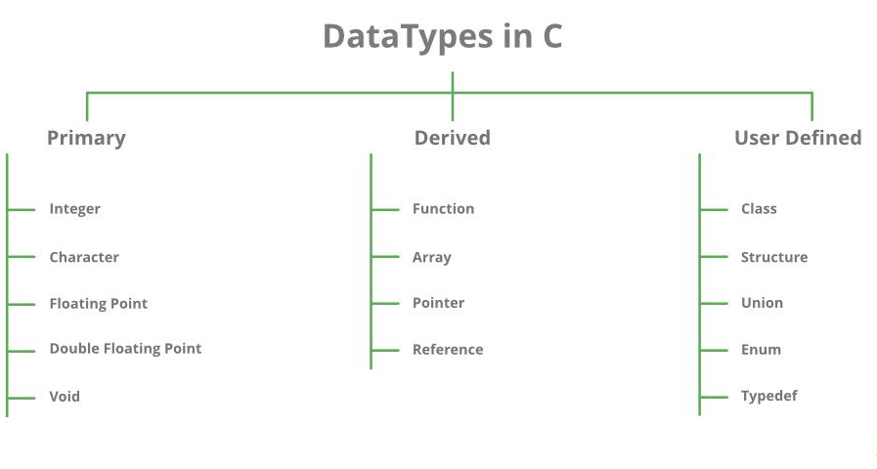


Slide 32
Primitive(Built-in) Data Types: Primitive Data types are defined by the language itself.
Primitive data types in C are the basic building blocks of data manipulation in the language. They are predefined by the compiler and provide a means to store simple values.
Integer:
The integer data type in C is used to store whole numbers (numbers without a fractional or decimal component). These numbers can be positive, negative, or zero.
Signed and Unsigned:
Signed integers can store both positive and negative values.
Unsigned integers store only non-negative values, effectively doubling the maximum positive range.
Variations:
short: Smaller range, typically 2 bytes.
long: Larger range, typically 4 or 8 bytes.
long long: Very large range, typically 8 bytes.

Slide 33
Variations of Integer Type:
Type | Size (bytes) | Range (Signed) : n = size * 8 Minimum Value = −2^{n−1} Maximum Value = 2^{n−1} −1 | Range (Unsigned) Minimum Value = 0 Maximum Value = 2^{n} −1
int | 4 | -2,147,483,648 to 2,147,483,647 | 0 to 4,294,967,295
short int | 2 | -32,768 to 32,767 | 0 to 65,535
long int | 4 or 8 | -2,147,483,648 to 2,147,483,647 | 0 to 4,294,967,295 (or higher)
long long int | 8 | -9,223,372,036,854,775,808 to 9,223,372,036,854,775,807 | 0 to 18,446,744,073,709,551,615

Slide 34
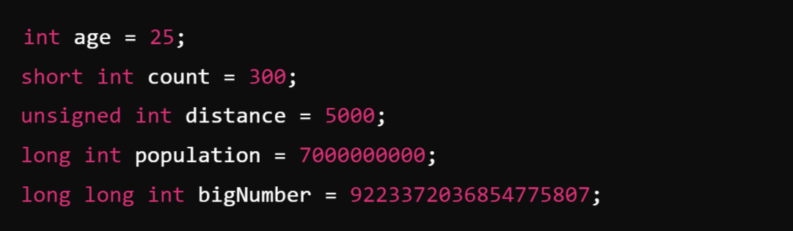
Example:

Slide 35
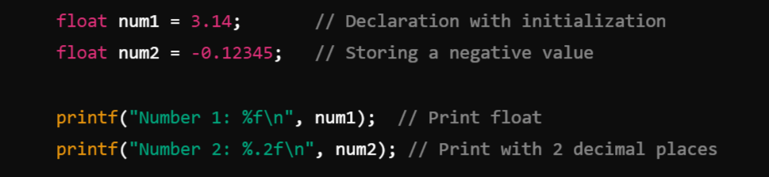
2. Floating Point:
The float data type in C is used to represent real numbers (numbers with fractional parts) in single precision. It is a primary data type that allows storing values with decimal points.
Storage Size:
Typically, 4 bytes (32 bits) on most systems.
The size can vary depending on the platform and compiler.
Example:

Slide 36
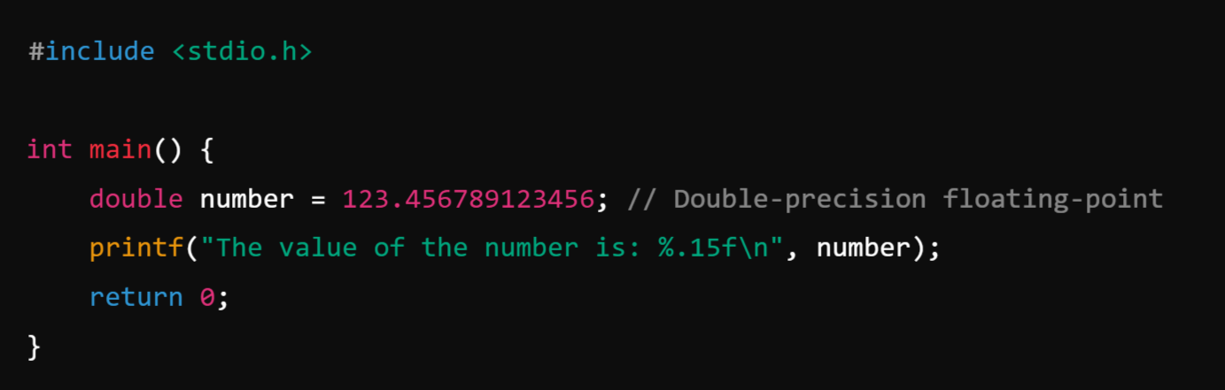
3. Double Floating Point:
Double Floating Point in C refers to a floating-point data type represented with 64 bits (8 bytes) of memory, offering double the precision of the standard float type.
Precision refers to the level of accuracy or detail with which a number is represented or stored in a computer. It determines how many significant digits a number can have.
Example:

Slide 37
Single Precision v/s Double Precision

Slide 38
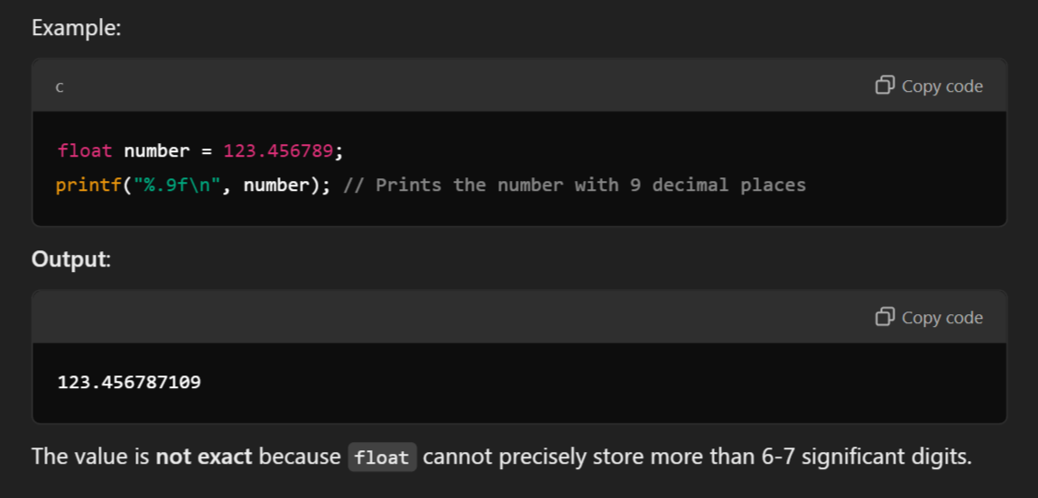
Single Precision (float):
Uses 4 bytes (32 bits).
Can represent numbers with approximately 6-7 significant decimal digits.

Slide 39
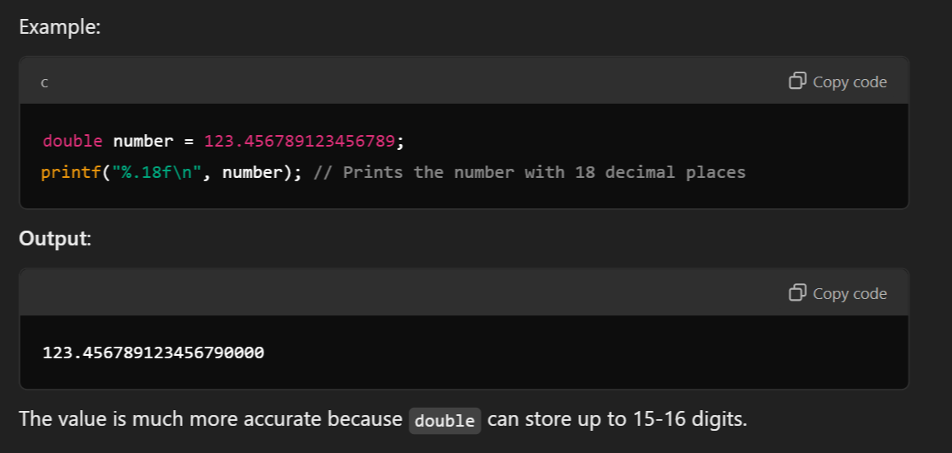
Double Precision (double):
Uses 8 bytes (64 bits).
Can represent numbers with approximately 15-16 significant decimal digits

Slide 40
4. Character:
The character data type (char) in C is used to store a single character. It is one of the primary data types and plays an imp
Key Points:
Size:
Typically takes 1 byte (8 bits) of memory.
Can store 256 different values (ranging from -128 to 127 for signed, or 0 to 255 for unsigned).
Purpose:
Represents single characters like letters, digits, and symbols (e.g., 'A', '1', '#').
Internally, the character is stored as an integer ASCII code.
Type Modifiers:
signed char: Stores values from -128 to 127.
unsigned char: Stores values from 0 to 255. ortant role in handling text and character data in programs.

Slide 41
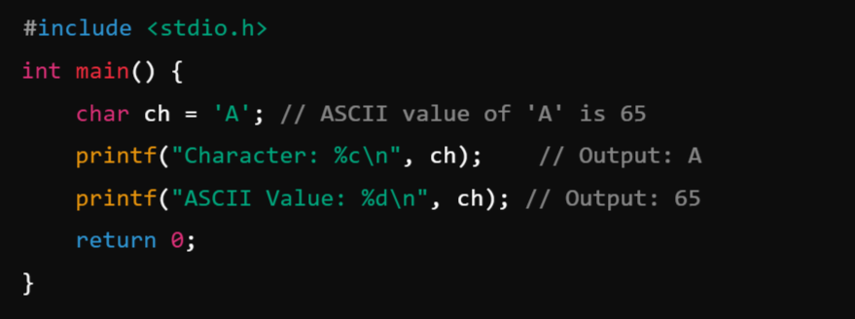
Example:

Slide 42
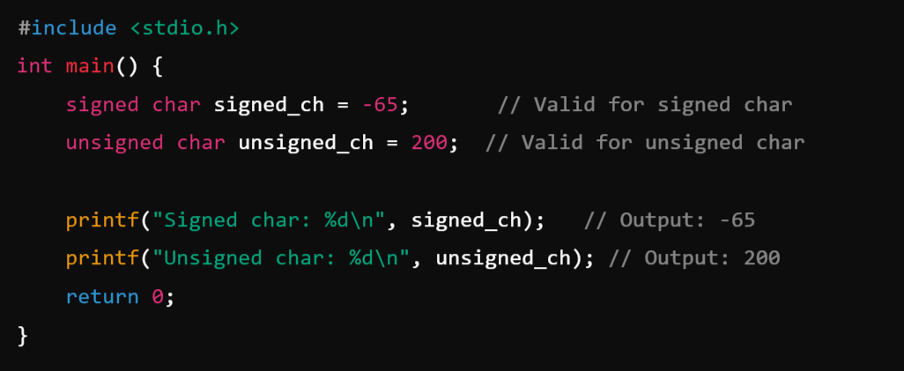
Example: Signed vs Unsigned

Slide 43
5. void:
The void data type in C represents the absence of any value or type. It is primarily used in situations where a function or pointer does not return or store any specific value.
Key Characteristics:
No Value:
A void type cannot hold any data or value.
It is often used to signify "nothing" or "no type."
Purpose:
Used as a function return type for functions that don't return any value.
Used in void pointers for storing addresses of variables of any type.

Slide 44
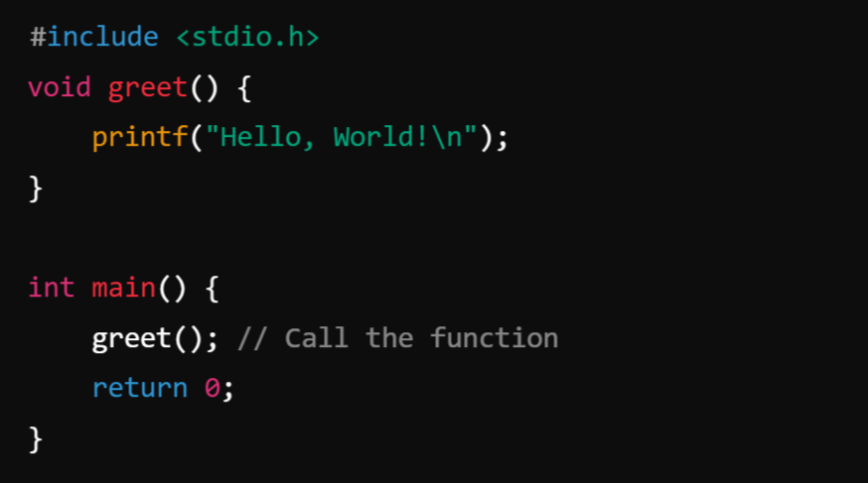
Example: A function declared with a void return type doesn't return any value to the calling function.

Slide 45
Module-1: BASICS OF C PROGRAMMING :
Introduction to programming paradigms: Applications of C Language, Structure of C program
C programming: Data Types, Constants, Enumeration Constants, Keywords.
Operators: Precedence and Associativity, Expressions, Input/Output statements, Assignment statements, Decision making statements, Switch statement, Looping statements Preprocessor directives, Compilation process.

